Slide 1

Exchange process

Slide 2
Summary of request
Request ID
2016-02-05
BF53XXX, First Lastname, +46 31 xxxxxxx
First lastname
BACKGROUND PDCA
EVALUATION OF COUNTERMEASURES PDCA
There is today no Information architecture or IT architecture that support the process for the physical testing (prepare and perform physical test). This makes it hard for all stakeholders to plan, re-plan and follow up the progress/status of the execution of the V&V-plan.
Text
CURRENT SITUATION PDCA
Different ways of working in the V&V organizations and between sites.
Several different domains with specific needs, maturity and tool chains.
No information architecture in place, no capability mapping is done and roadmap for existing tools are incomplete.
Limited re-usage of metadata produced during test
Difficult and time consuming to find metadata
Copy of same data is stored in different systems and metadata owner for this data is not defined
Data information exchange between different systems are not well defined or existing
Plan and re-plan of the test related activities are time consuming, with a lot of manual work.
PURPOSE and TARGET PDCA
ACTION PLAN PDCA
Secure that the TCP supports the applications and tools included in the ”Prepare and Perform Physical Test” process.
Secure the needed metadata for all stages in the process, including metadata created in other interfaced processes (input and output).
Create metadata once and re use / updates during the whole process.
Implement a policy for lifecycle management of metadata / test data.
Secure the needed metadata definitions.
Support for planning and re planning of all test related activities.
Documented and implemented information architecture and IT architecture
Text
FOLLOWUP PDCA
Text
ROOT CAUSE ANALYSIS ref GDI 968-08 PDCA
No Global process implemented on all sites.
There is no documented information architecture and IT architecture for “Prepare and Perform Physical Test” process.
No capability mapping is done and roadmap for existing tools are incomplete.
There is no function available for finding test data across individual solutions and sharing test data between sites
We lack common metadata and structure from tests.
There is no policy for lifecycle management of metadata / test data.
Manual input from the V&V plan today, only excel doc exists.
No follow up if the process and methods are in place and works.
Several different V&V domains with specific needs, maturity and tool chains.
No general definition of roles.
Tests done with out any test requests.
STANDARDIZE PDCA
Text

Slide 3
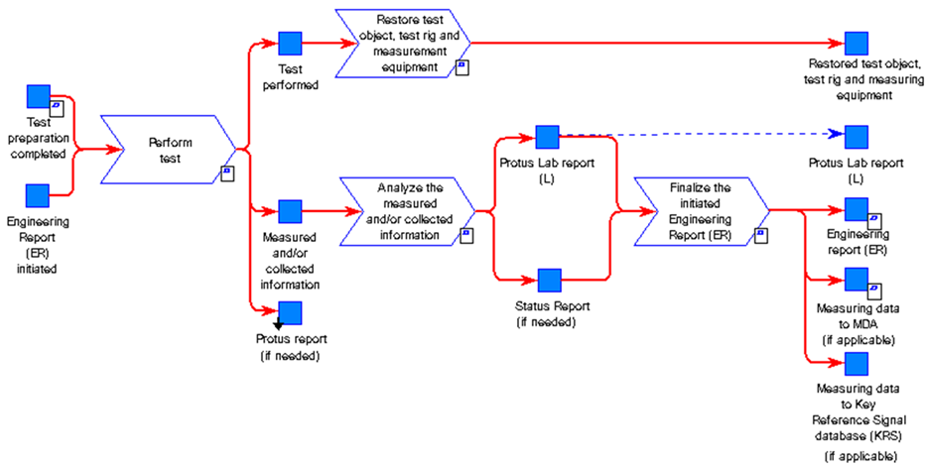
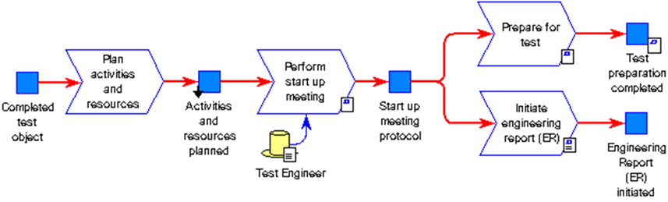


TO-BE
TCP
Test Collaboration Platform
GTDM Scope
Up- date
Re-plan
BOSS
GHOST
Test Manager
Incl Test Module?
HPG Planning tool
AXXOS
V&V plan
Defines acceptance criteria and methods. Selecting test objects and create time plan.
Test request
Based on V&V plan the test should be initiated e.g. n-8 weeks before the actual test should start.
In order to secure parts, material, resources and test object build. Quotation secured.
Plan activities and resources All needed resources and budget is secured.
Prepare for test The test object is
e.g. prepared with measurement equipment. The test procedure and method is prepared and secured.
Analyze/Reporting
Perform test Measurement systems and tools are efficient and control and give support during the test execution. E.g. test procedure, KPI, progress and status is available (results/running/faults found).
PROTUS
Vehicle Logging Tool
Data handling
Results and data are analyzed, documented and published. The data is also made available to upload for analysis or as input for future testing.
GHOST incl Test Module ?
Data information exchange
”Test Collaboration Platform”

Slide 4


TCP Workflow
Create reporting on metadata
Define Information Concept Model
Appoint Master Data
Implement exchange process
GHOST
PROTOM
BI/Dashboard
GTDM
KRS
POOLMAN
EFACTS

Slide 5
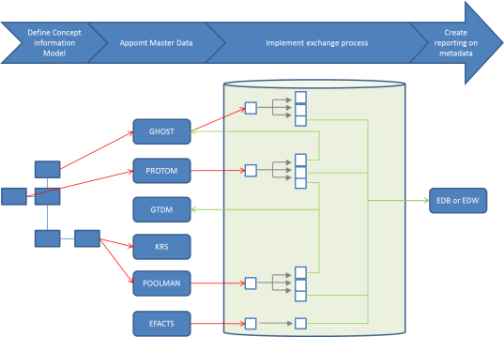
STEP 3: Exchange process
Main requirements:
Real time management
Data historization
Create global output with main metadata
Have capacity to manage Request & Reply

Slide 6



STEP 3:
Exchange process
KOLA
PROTOM
EFACTS
RDM
Source applications
Service TCP consumer
TCP
Transformation area
Service TCP provider
GHOST
EFACTS
GTDM
Consumer

Slide 7
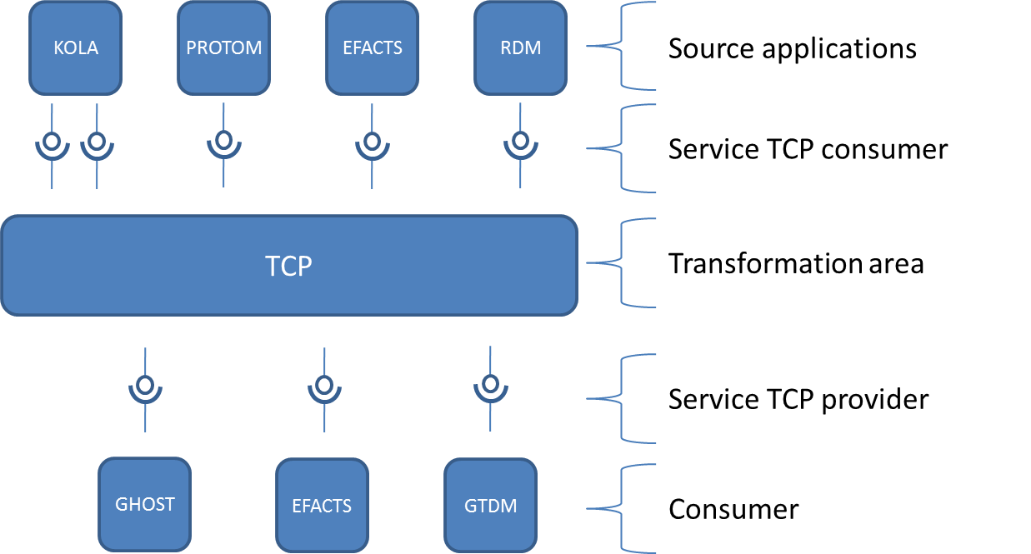
Source application and Service TCP Consumer
All metadata linked to a test could be integrated to TCP from master source system.
TCP integration has to be in line with the Integration policy from Volvo group:
Integrate data directly from master source system
Reuse existing service from source application if it’s possible
Used MQ technology to exchange information.
Create adaptor in TCP side if it’s required

Slide 8
Transformation area

Slide 9
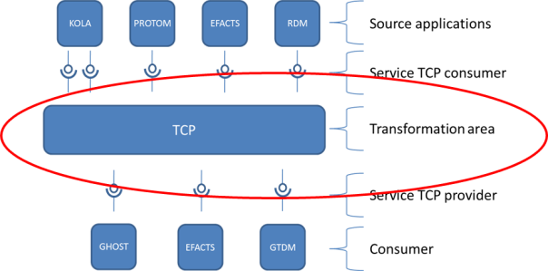
Why we would like create a common transformation area?
Service Bus
More than 100 source applications (provider)
More than 100 target applications (consumer)
Without common « adapter », how many exchange process?
KOLA
PROTOM
EFACTS
RDM
syncVariant
syncTestObject
syncEfacts
syncRDM
ADAPTER
ADAPTER
One common adapter could cover the need for 80% of GTT Test applications
GTDM
GHOST

Slide 10
IT Solutions
IT Solutions for TCP:
PLM BUS
New Database
HUB Layer
HUB/MDM/DWH Layers
GHOST
EDB
KOLA
PROTOM
EFACTS
RDM
syncVariant
syncTestObject
syncEfacts
syncRDM
Real time management
Data historization
Create one global output with main metadata
Merge for specific output
TCP
syncTestMetadata
syncTestFullMeta
GHOST
EFACTS
GTDM

Slide 11
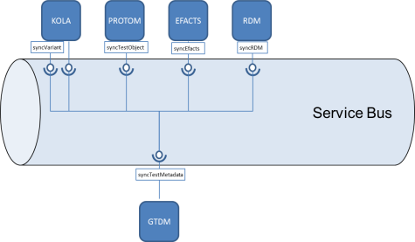
No new application: Manage transformation via the service bus
Service Bus
KOLA
PROTOM
EFACTS
RDM
syncVariant
syncTestObject
syncEfacts
syncRDM
syncTestMetadata
GTDM

Slide 12
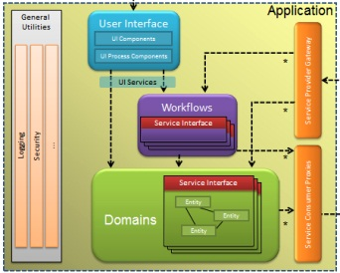
Service Bus Concept
Service Bus
A Service Bus will provide at least Connectivity, Routing and a common information model implemented by a canonical message format (maybe more than one)
New applications should be Service Bus compliant (will reduce future maintenance cost)
Implement adapters for non compliant applications
Connectivity
Routing
Canonical message format
Application
ownership
adapter
Protocol conversion
Message transformation
Routing information
Application A - Service bus compliant
Application B - Legacy or
COTS
Notes:
The ambition for each domain is to look for existing open standards based information models and canonical formats instead of inventing everything from scratch. If there is no suitable standards available development of an in-house model will be required.
The Volvo business domains are few and large – as a consequence we will probably see more than one model and format in each domain.

Slide 13
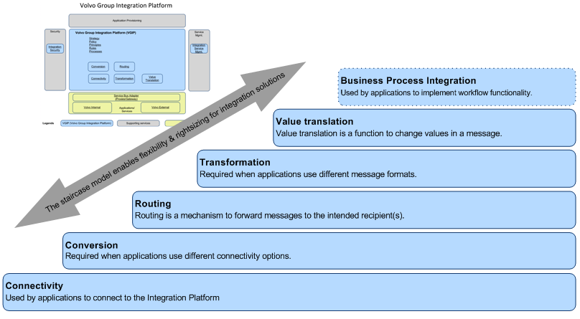
Staircase model
Notes:
Service Consumers and Providers should strive for commonality in integration terms – implementing a domain Service Bus using a common Connectivity mechanism, a common Message format and a common routing architecture will limit the need for more complex integration functionality in the Integration Platform. Most application domains will however live with a complex structure of old and new applications for a long time. They need to manage the change and transition to a target architecture and during that transition they will need more advanced mediation functionality in the integration platform. And even after the transition (an ever lasting process of change) you will face the need for mediation services – especially when more COTS solutions is part of the application portfolio. But do not use more integration infrastructure components than necessary – will introduce complexity and extensive cost.

Slide 14
No new application: Manage transformation via the servive bus
Consume even driven messages? Y
Provide even driven messages? Y
Data transformation capacity? N : No capacity to merge several sources
Service capacity? Y
Historization/Versionning capacity? N: No capacity to store data.
PLM Service Bus could not be used for the transformation area.
However, it could be interesting to provide TCP Service via the PLM Service Bus.

Slide 15
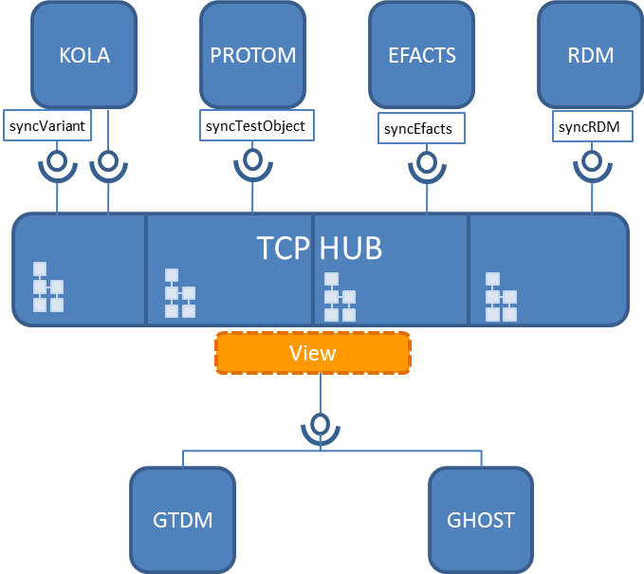
New application: HUB Database
KOLA
PROTOM
EFACTS
RDM
syncVariant
syncTestObject
syncEfacts
syncRDM
Integration from Event Driven services. API to read MQueue
TCP HUB
SQL Server Database. One schema per source system. Modelisation in line with source system. Historization and versionning
View
Provide data via services (several integrations pattern). Output could be based on View (Adapter layer).
syncTestMetadata
GTDM
GHOST

Slide 16


New application: HUB Database
Easy to add new source
Flexibility
Capacity to manage realtime
AGIL Compliant
Limitation on MDM/No business knowledge
Limitation to merge information « Adapter layers »

Slide 17
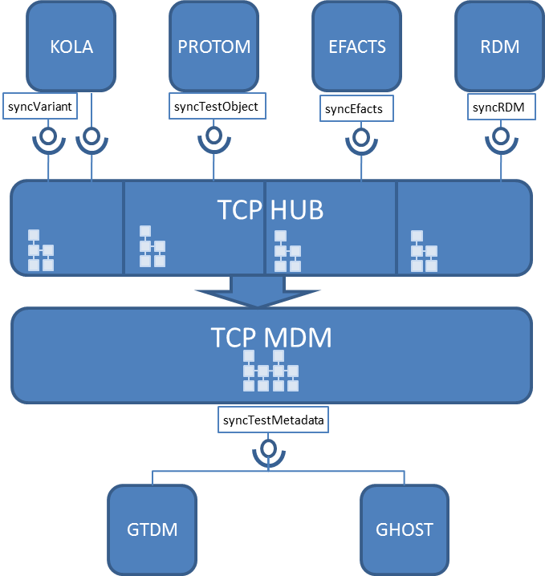
New application: HUB/MDM/DWH Database
KOLA
PROTOM
EFACTS
RDM
syncVariant
syncTestObject
syncEfacts
syncRDM
Integration from Event Driven services. API to read MQueue
TCP HUB
SQL Server Database. One schema per source system. Modelisation in line with source system. Historization and versionning
TCP MDM
Create common DWH to create links between metadata. Do master data management to clean information.
syncTestMetadata
Provide data via services (several integrations pattern).
No adapter is required .
GTDM
GHOST

Slide 18
New application: HUB/MDM/DWH Database
Provide knowledge to downstream applications
Easy to add new specific extraction
Huge capacity to transform data
Need huge maturity on metadata
Expensive and time consuming for new implementation
Complexity to manage real time

Slide 19

GHOST
Infra:
SQL Server 2012
Object oriented model based on key value → Flexible model
Operational database for GHOST
Capacity to store other application on other schema
Event driven integration capacity:
Not yet develop but could be implemented.
Real time capacity (output)
Complexity to manage real time.
Data transformation capacity
ORM: NHIBERNATE (Between database)
.NET (for In House)
Service capacity
OK
Volume capacity
SQL Server 2012
Historization/Versioning capacity
OK

Slide 20
GHOST
-
Contains already DWH level
Have already data from several steps of process
Main application for test and MDM for the first step
Capacity to transform data
Relational database: need huge maturity.
Expensive and time consuming to add new information.
Interface dependencies for the back-end
Complexity to implement real time between layers

Slide 21
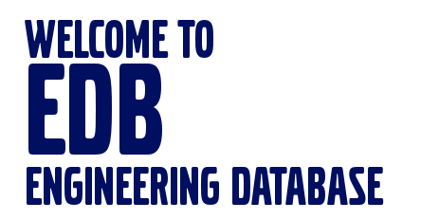
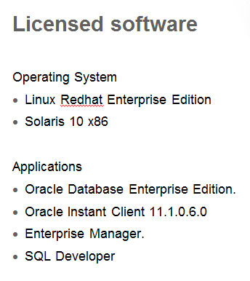
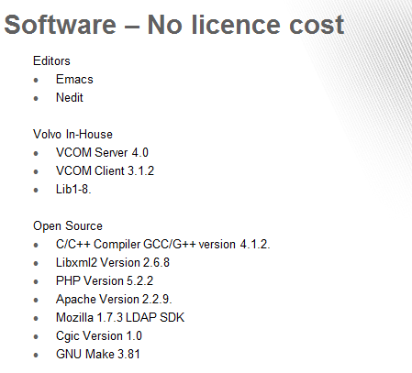
EDB Platform
To Be Updated

Slide 22
EDB Platform
ROADMAP:
EDB target is not to be a HUB.
EDB is already a operational database and a reporting application. Let see EDB as Reporting tools for TCP.
-
Contains already DWH level
Have already data from several steps of process and master data (KOLA…)
Have knowledge…
Relational database: less flexibility, need huge maturity
Interface dependencies for the back-end
Complexity to implement real time between layers
→ New source : Big cost and time needed
No investigation requested

Slide 23
Transformation Area
 | Capacity: Real Time | Capacity: Data Historization | Capacity: Transfor-mation | Flexibility | One-Time | Run-Time | Architecture principles
Service Bus
Database Hub
Database DWH
GHOST
EDB
-----------------------------------EDB Roadmap---------------------------------------

Slide 24
Service TCP Provider
The aim of TCP is to provide new service to cover needs from several consumer.
This service:
Merge information from several source system. If consumer would like information from one source system, it has to reuse source system service.
Could be implemented with several pattern (Pub/Sub, Request/Reply) following the downstream application requirements
Could be implemented on the PLM service bus

